Slide 1
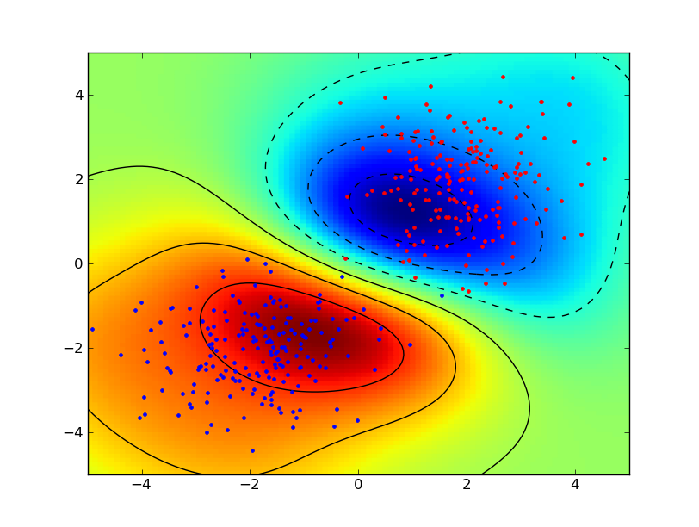
Support Vector Machines
Elena Mokshyna
Odessa
2014

Slide 2
Plan
What’s SVM – Intuition & Math behind
Kernel trick, huh?
SVM for regression
Recommendations
Some kernels
Different R libraries
Advantages & Disadvantages

Slide 3
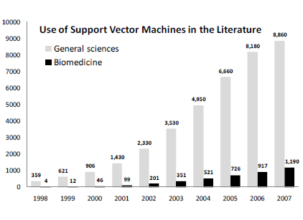
A bit of history
Support vector machine classifiers have a long history of development starting from the 1960’s.
The most important milestone for development of modern SVMs is the 1992 paper by Boser, Guyon, and Vapnik(“A training algorithm for optimal margin classifiers”)

Slide 4
What’s SVM - intuition
x₂
x₁

Slide 5
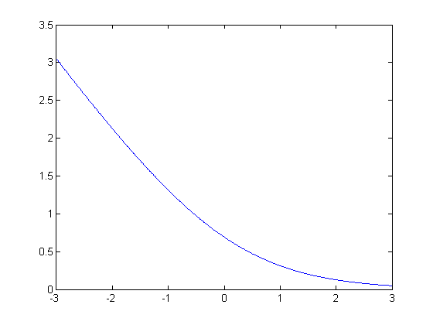
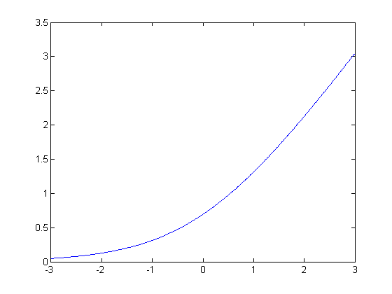
LIKE and NOT LIKE logistic regression
Logistic regression:
Support vector machine:
If (want ):
If (want ):

Slide 6
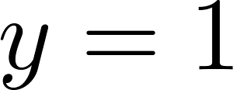
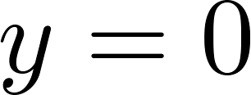
Sigmoid function.. again
If , we want ,
If , we want ,
Cost of example:

Slide 7
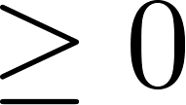
NOT LIKE logistic regression
Support Vector Machine
-1
1
-1
1
If , we want (not just )
If , we want (not just )
C = 100 000

Slide 8
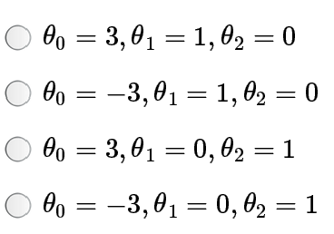

Slide 9
So how does it look like?
In general – LARGE MARGIN CLASSIFIERS
Find a classifier (hyperplane)
An infinite number of such hyperplanes exist.
Find the hyperplane that maximizes the gap between data points on the boundaries (so-called “support vectors”).
x₂
margin

Slide 10
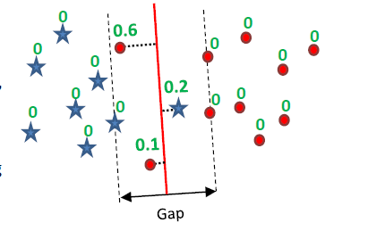
“Soft-margin” linear SVM
Use so-called slack variable ξ
Subject to:
Outside the margin or on the margin
Inside the margin correctly classified
Inside the margin misclassified
Notes:
Slack variable – фиктивная переменная (зазор)

Slide 11
SVM: introducing nonlinearity
x₂
Need to generate new features!

Slide 12
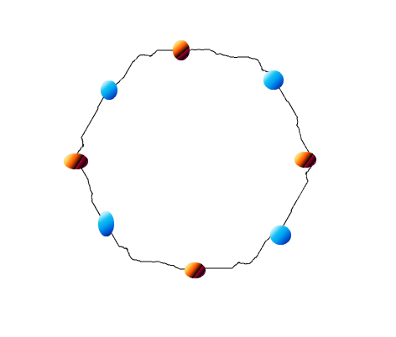
Kernel trick, huh?
There is no straight line (hyper plane in 2 dimensions) which can separate red and blue dots.
Generate more features!
Inseparable data! T________T
What to do? ☹

Slide 13
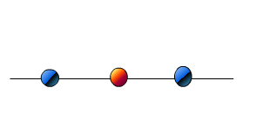
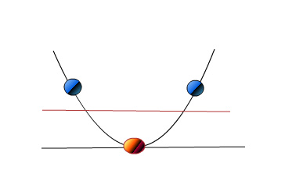
Kernel trick, huh? Simple as it is
Inseparable data
project all points up to a two dimensional space using the mapping
Voila! We can indeed find a hyper plane to separate data with SVM.
The mapping in this case is called KERNEL FUNCTION

Slide 14
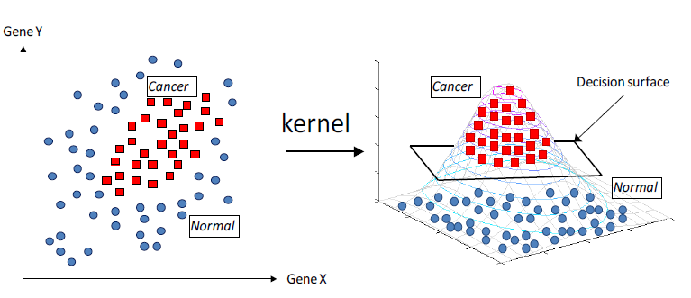
Example of kernel trick

Slide 15
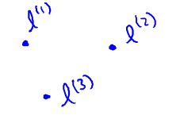
Kernel trick in practice
x₂
f is approx 1
f is approx 0

Slide 16
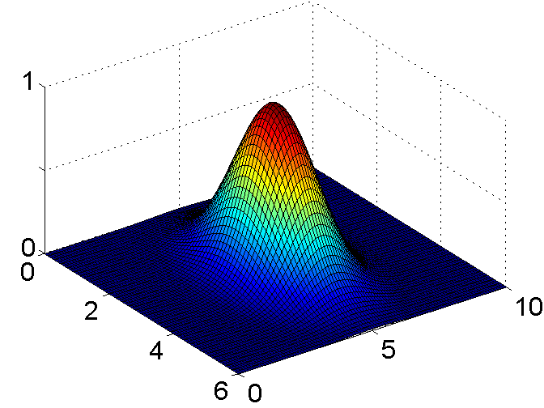
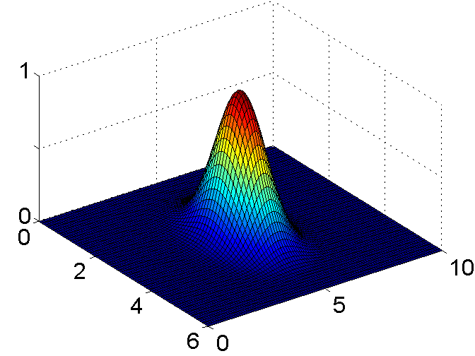
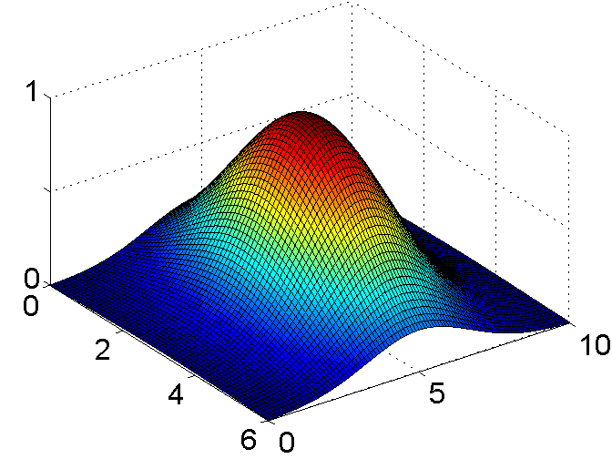
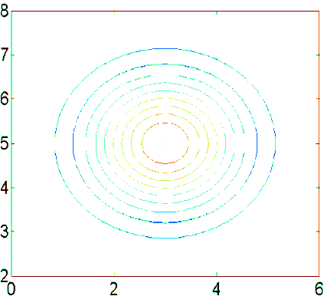
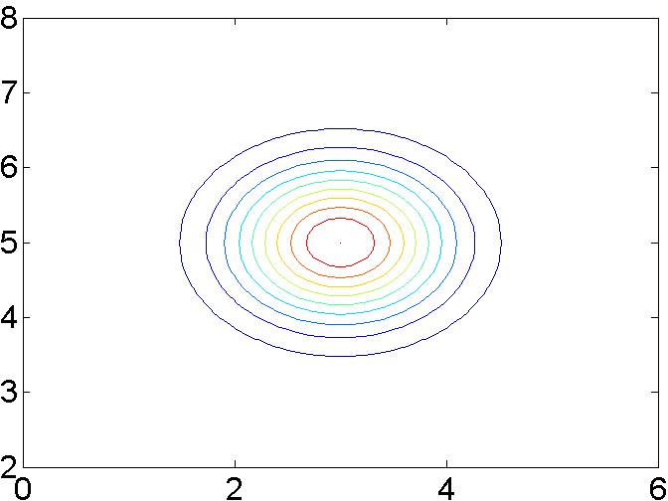
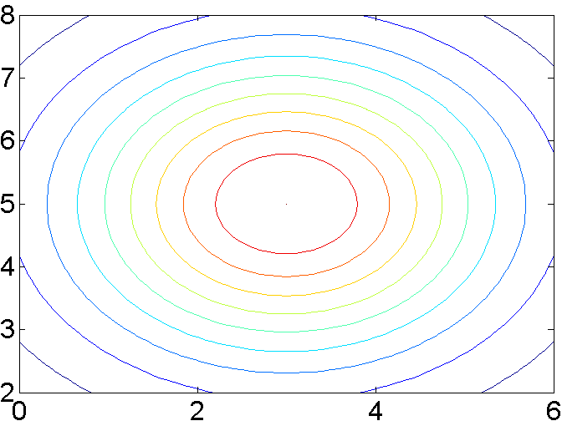
SVM with radial basis kernels: sigma

Slide 17
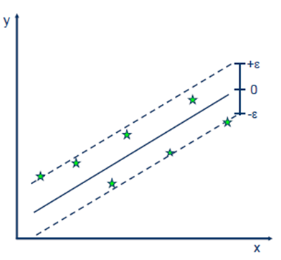
Support Vector Regression
Do kernel trick
Build linear model using parameter ε - precision

Slide 18
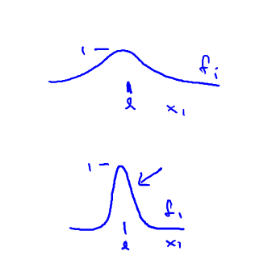
Recommendations
C ( ). Large C: Lower bias, high variance.
Small C: Higher bias, low variance.
Small λ
Large λ
Large : Features vary more smoothly.
Higher bias, lower variance.
Small : Features vary less smoothly.
Lower bias, higher variance.

Slide 19
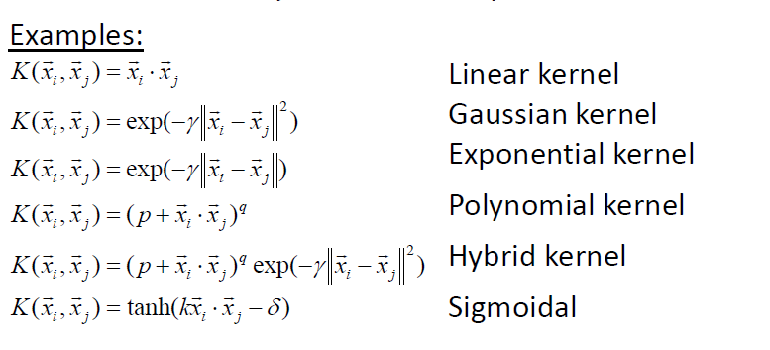
Kernels

Slide 20
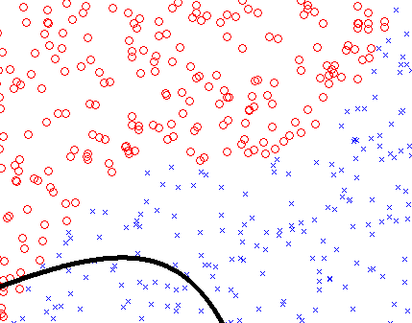
R: SVM implemetations
Five packages that implement SVM in R:
e1071
kernlab
klaR
svmpath
shogun

Slide 21
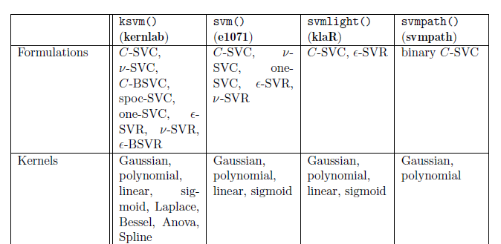
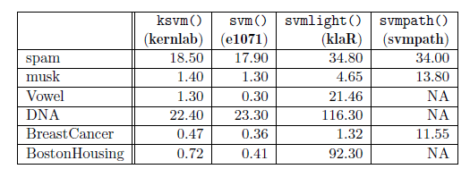
Libraries’ comparison
Alexandros Karatzoglou. Support Vector Machines in R// http://www.jstatsoft.org/, 2006

Slide 22
SVM advantages
Flexibility in the choice of the form of the threshold
Robustness towards small number of data points
SVMs deliver a unique solution
You can do almost anything with the right kernel (tricky!)

Slide 23
SVM disadvantages
If the points on the boundaries are not informative (e.g., due to noise), SVMs will not do well.
Can be computationally expensive
"However, from a practical point of view perhaps the most serious problem with SVMs is the high algorithmic complexity and extensive memory requirements.." Horváth (2003) in Suykens et al. p 392
"Besides the advantages of SVMs - from a practical point of view - they have some drawbacks. An important practical question that is not entirely solved, is the selection of the kernel function parameters…" Horváth (2003) in Suykens et al.

Slide 24
What we missed here (for our own good & sake of time)
Relevance vector machines (RVM)
Quadratic programming
Loss functions
Different types of kernels
(loads of them!)
One-class SVM
SVM-based variable selection
SVM usage to calculate posterior class probabilities
All the differences in library implementations

Slide 25
References
!!! Cousera’s Machine Learning with Andrew Ng: https://www.coursera.org/course/ml
SVM without Tears: http://webdoc.nyumc.org/nyumc/files/chibi/user-content/Final.pdf
Quora: http://www.quora.com/Machine-Learning/What-are-Kernels-in-Machine-Learning-and-SVM
http://stats.stackexchange.com/questions/2499/explain-what-a-kernel-is-in-plain-english

Slide 26
Thank you for the attention!

Slide 27
